Slide 1

DEVOPS CI/CD
A quick overview

Slide 2


AGENDA
What is devops
Introduction to CI/CD
CI/CD Best practices
FULLSTACK vs. DEVOPS
DEVOPS TOOLS
BENEFITS OF DEVOPS
TOOLS AVAILABLE FOR CI/CD

Slide 3

WHAT IS DEVOPS?
DevOps is the combination of cultural philosophies, practices, and tools that increases an organization’s ability to deliver applications and services at high velocity: evolving and improving products at a faster pace than organizations using traditional software development and infrastructure management processes. This speed enables organizations to better serve their customers and compete more effectively in the market.

Slide 4




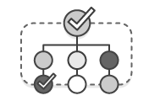
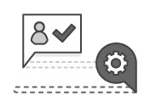

BENEFITS OF DEVOPS
SPEED
RAPID
DELIVERY
RELIABILITY
SCALE
IMPROVED
COLLABORATION
SCALE

Slide 5
SPEED
Move at high velocity so you can innovate for customers faster, adapt to changing markets better, and grow more efficient at driving business results. The DevOps model enables your developers and operations teams to achieve these results. For example, microservices and continuous delivery let teams take ownership of services and then release updates to them quicker.

Slide 6
RAPID DELIVERY
Increase the frequency and pace of releases so you can innovate and improve your product faster. The quicker you can release new features and fix bugs, the faster you can respond to your customers’ needs and build competitive advantage. Continuous integration and continuous delivery are practices that automate the software release process, from build to deploy.

Slide 7
RELIABILITY
Ensure the quality of application updates and infrastructure changes so you can reliably deliver at a more rapid pace while maintaining a positive experience for end users. Use practices like continuous integration and continuous delivery to test that each change is functional and safe. Monitoring and logging practices help you stay informed of performance in real-time.

Slide 8
SCALE
Operate and manage your infrastructure and development processes at scale. Automation and consistency help you manage complex or changing systems efficiently and with reduced risk. For example, infrastructure as code helps you manage your development, testing, and production environments in a repeatable and more efficient manner.

Slide 9
IMPROVED COLLABORATION
Build more effective teams under a DevOps cultural model, which emphasizes values such as ownership and accountability. Developers and operations teams collaborate closely, share many responsibilities, and combine their workflows. This reduces inefficiencies and saves time (e.g. reduced handover periods between developers and operations, writing code that takes into account the environment in which it is run).

Slide 10
SECURITY
Build more effective teams under a DevOps cultural model, which emphasizes values such as ownership and accountability. Developers and operations teams collaborate closely, share many responsibilities, and combine their workflows. This reduces inefficiencies and saves time (e.g. reduced handover periods between developers and operations, writing code that takes into account the environment in which it is run).

Slide 11

MISCONCEPTIONS ABOUT DEVOPS
It’s Not NoOps
It’s Not (Just) Tools
It’s Not (Just) Culture
It’s Not (Just) Devs and Ops
It’s Not (Just) A Job Title
It’s Not Everything
What is DevOps Not?

Slide 12


FULLSTACK DEVELOPER
V S
DEVOPS ENGINEER

Slide 13
FULLSTACK vs. DEVOPS
FULLSTACK DEVELOPER
DEVOPS ENGINEER
Have skillset in multiple technical areas
They also use devops tools such as Docker, Vagrant
Mostly involved in development integration.
A term often used to describe someone who develops frontend, backend, and db queries, often spanning multiple languages and markup styles such as python, JavaScript, html, and css.
DevOps Engineers highly depend on tool-usage than full-stack developers.
They also use full stack technologies like Python, Javascript and PHP
They are mostly involved in deployment responsibilities
Dev + Ops, meaning you build infrastructure as code, manage dev, staging, and production infrastructure. You get alerts in the middle of the night and you fix things magically because you may be the only person in the whole org that knows how it all fits together

Slide 14


Blurring the line between full-stack and DevOps
It’s an interesting tale of how working practices develop according to necessity and how methodologies and ideas interact with the practical details of a given situation. It tells the story of how the Washington Post went about building its submission platform, and how the way in which the project was resourced and managed changed according to certain pressures – internal and external. The title might actually be misleading – if you read it, it’s not so much that DevOps necessitates full-stack development, more that each thing grows out of the next. It might even be said that the reverse is true – that full-stack development necessitates DevOps thinking.
The relationship between DevOps and full-stack development gives a real indication of the state of the tech world in 2015. Within a tech landscape of increasing complexity and cross-pollination there are going to be opportunities for developers and engineers to significantly drive their value as technical professionals. It’s simply a question of learning more, and of being open to new challenges and ideas about how to work effectively. It probably won’t be easy, but it might just be a fun journey.

Slide 15

FREQUENTLY USED DEVOPS TOOLS
GRADLE: A reliable build tool
GIT: The most popular Source Control Management tool
JENKINS: Open source go-to automation tool
BAMBOO: CI/CD server solution
DOCKER: Container platform
KUBERNETES: Container orchestration platform
PUPPET ENTERPRISE: Configuration management platform
ANSIBLE: Configuration management tool
NAGIOS: Monitoring tool
RAYGUN: Error monitoring and crash reporting platform

Slide 16
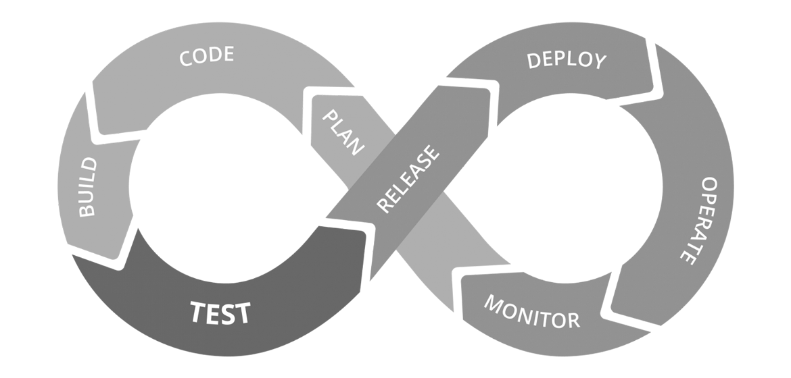
An Introduction To CI/CD
The adoption of CI/CD has changed how developers and testers ship software. Developer approaches are always changing: long ago, we had Waterfall, then it was Agile, and now it's DevOps. DevOps is how modern developers are building great products. The new methods of Continuous Integration, Continuous Delivery (CI/CD), and Continuous Deployment have come with the rise of DevOps. Conventional software development and delivery methods are rapidly becoming obsolete as deployment frequency increases.
How the CI/CD pipeline flows

Slide 17
Continuous Integration (CI)
T
E
R
M
S
Focuses on blending the software work products of individual developers together into a repository.
This can be done several times a day.
Primary purpose being to enable early detection of integration bugs.
CI allows for tighter cohesion and more development collaboration.

Slide 18
Continuous Delivery (CD)
T
E
R
M
S
Main focus is to minimize the friction points that are inherent in the deployment or release processes.
A team's implementation involves automating each of the steps for build deployments so that a safe code release can be done at any moment in time.
Build software in such a way that the software can be released to production at any time.

Slide 19
Continuous Deployment
T
E
R
M
S
is a higher degree of automation, in which a build/deployment occurs automatically whenever a major change is made to the code.
In such a process, there is no need for a person to decide when and what goes into production.
Organizations that employ continuous deployment will benefit immensely from the ability of users to give quick feedback on new deployments.

Slide 20

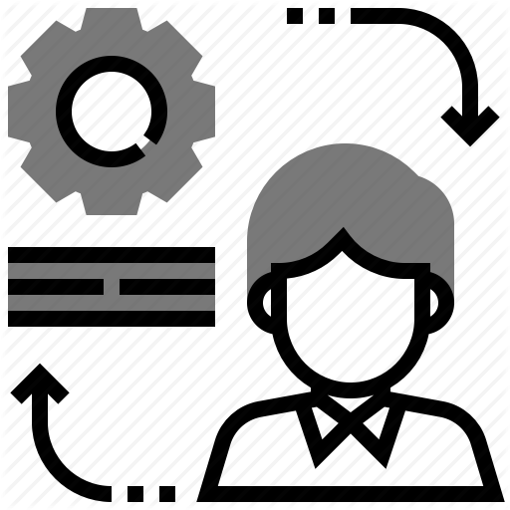
CI/CD BEST PRACTICES
Tools are temporary, do not get tied up to one tool.
Save build artifacts on a remote location (disc space finishes up really really fast).
Package first, then run jobs.
Use separate VM or containers for each job.
Parallel jobs are good, but implement only when needed
CI/CD doesn’t mean no manual testing
Unit tests are big investment when your project is new
Build all branches, not just trunk/master
Pipelines should be matured slowly instead of in one-go

Slide 21
TOOLS USED FOR CI/CD
JENKINS: One of the best solutions out there, both powerful and flexible at the same time. The learning curve could be a bit steep, but if you need flexibility it very well pays off to learn how to use it.
TEAMCITY: Great solution overall, but due to its complexity and price, better suited for enterprise needs.
TRAVIS CI: A Mature solution that offers both hosted and On-premises variants, loved and used by many teams, very well documented.
GO CD: On-premises solution, great for complex scenarios, free of charge with paid support.
CODEFRESH: Easy to use tool with Docker containers at its core and very nice feature of launching the built Docker images to the hosted environment.
BAMBOO: Great On-premises CI tool that originally offered Cloud solution too. Bitbucket Pipelines replaced the cloud solution. Pipelines is a modern and fast cloud CI tool integrated into Bitbucket. Has a free trial for 30 days, and paid plans after that.
GITLAB CI: A Phenomenal hosted tool with impressive list of features, offers both free and enterprise solutions.
CIRCLE CI: Flexible cloud CI tool that offers parallelization up to 16x. Excellent if you need something built fast and money is not the biggest issue
CODESHIP: Powerful hosted solution with docker support, flexible plans suited both for small teams and enterprises alike.

Slide 22
Thank You
YOU CAN’T DO A GOOD JOB IF YOUR JOB IS ALL YOU DO
-Unknown
NEVER GET SO BUSY MAKING A LIVING THAT YOU FORGET TO MAKE A LIFE
-Dolly Parton
Avinash.j@prodapt.com

